Slide 1
Advanced NGS Analysis (Day 1) Session II
Lyda Hill department of Bioinformatics 2022 Nanocourse Series
Date & Time: June 27-28: 9AM-5PM (NG3.202)
Course Instructors: Bo Li, Daehwan Kim, Christopher Chaney, & Micah Thornton (micah.Thornton@utsouthwestern.edu)

Slide 2
Day 1: RNA-Seq Analysis Using Pseudo/Quasi-Alignment and Expectation Maximization (Kallisto, Salmon).

Slide 3
Part 1: Pseudo and Quasi Alignment & Quantification Resolution

Slide 4
RNA-Seq Experiments (Key Difference from DNA)
In DNA-Seq, we usually align ‘NGS sequencing reads’ to a reference genome.
These sequences include all exons and introns, in fixed order.
In RNA-Seq on the other hand we might try to align to a ‘transcriptome’.
These include a set of ‘transcripts’ which contain different possible sequences encoded by the same gene
Gene A
E1
E2
E3
E4
Transcript 1
E1
E3
E4
Gene A
Transcript 2
E1
E2
E3
Transcript 3
E2
E3
E4

Slide 5
RNA-Seq Experiments (Key Questions)
In RNA-Seq experiments researchers hope to answer questions such as:
How do abundances of a particular gene transcripts in the same population vary?
Ex. Do subjects with a high abundance of transcript A, tend also to exhibit relatively high abundances of transcript B?
Do the abundances of gene transcripts vary with some observable phenotypic characteristic?
Ex. Do patients with latent state tuberculosis exhibit more abundance of transcript A than those with active state?
What constitutes the most likely genetic transcript profile for a particular subject?
Ex. Is Transcript A more abundant in this subject?
Etc …
So if we do not have exact positional alignments for reads, that is okay, as long as we are able to determine the most likely transcript that they came from. (Expectation Maximization for Multinomial Data)

Slide 6
RNA-Seq Experiments Overview
In some RNA-Seq Experiments the actual alignment of reads may not be measurable in some cases.
For instance, consider the following small example,
Sequencing Reads
Transcript 1
ACCCCGAGAGTTAGAGCGTGTGAGAGAA
GAGTTA
GACTTT
CGTGTG
GAGCGT
Transcript 2
ACCCCGAGAGGGAAGAGACTTTAGAGCGT
Transcript 3
GGAAGAGACTTTAGAGCGTGTGAGAGAA
It is possible that many RNA-Seq reads might be compatible with the same transcripts.
Therefore for each of the RNA-Seq reads, the actual alignment is not directly recoverable.

Slide 7
RNA-Seq Experiments Overview
Instead of working directly with the sequences to produce positional alignments (the exact position where the read came from), coarsened compatibility patterns may be observed for the transcripts the read is compatible with.
From the previous example,

Slide 8
RNA-Seq Experiments Overview
Instead of working directly with the sequences to produce positional alignments (the exact position where the read came from), coarsened compatibility patterns may be observed for the transcripts the read is compatible with.
From the previous example,
Sequencing Reads
Transcript Compatibility Pattern
Transcript 1
ACCCCGAGAGTTAGAGCGTGTGAGAGAA
GAGTTA
GACTTT
CGTGTG
GAGCGT
100
011
101
111
Transcript 2
ACCCCGAGAGGGAAGAGACTTTAGAGCGT
Transcript 3
GGAAGAGACTTTAGAGCGTGTGAGAGAA

Slide 9
RNA-Seq Experiments Overview
Now suppose that there are 10 Million such reads aligning to the transcriptome.
Since positional alignment information may not allow the discernment of transcripts,
Not necessary to determine and report such information.
Instead, many RNA-Seq transcript quantification tools use the following general procedure:
Reference
Transcriptome
RNASeq Sequencing Reads File
Transcript
Abundance
Estimates
Pseudo-Alignment
Expectation Maximization
Determine which transcripts each read is compatible with and count occurrences of specific ‘compatibility patterns’
Use Iterative approach to estimate specific abundances from ‘coarsened’ data (IE, get specific transcript counts from general)

Slide 10
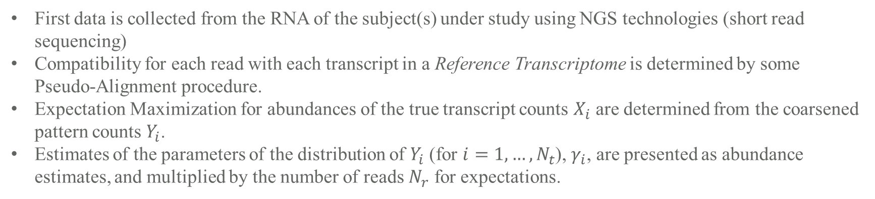
RNA-Seq Experiments Overview
RNASeq Sequencing Reads File
Transcript
Abundance
Estimates
Pseudo-Alignment
Expectation Maximization
Reference
Transcriptome
First data is collected from the RNA of the subject(s) under study using NGS technologies (short read sequencing)
Compatibility for each read with each transcript in a Reference Transcriptome is determined by some Pseudo-Alignment procedure.
Expectation Maximization for abundances of the true transcript counts $X_{i}$ are determined from the coarsened pattern counts $Y_{i}$.
Estimates of the parameters of the distribution of $Y_{i}$ (for $i=1,…,N_{t}$), $γ_{i}$, are presented as abundance estimates, and multiplied by the number of reads $N_{r}$ for expectations.

Slide 11
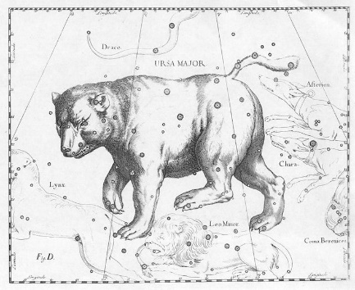

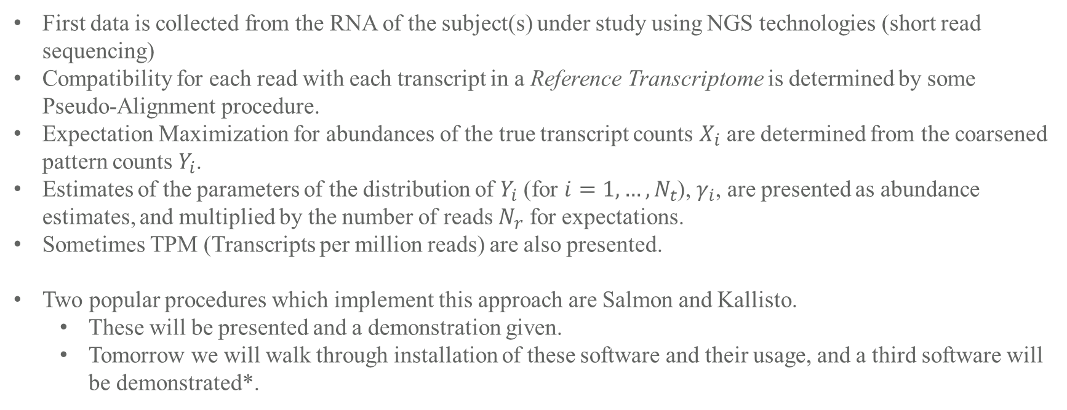
RNA-Seq Abundance Estimation: Kallisto
First data is collected from the RNA of the subject(s) under study using NGS technologies (short read sequencing)
Compatibility for each read with each transcript in a Reference Transcriptome is determined by some Pseudo-Alignment procedure.
Expectation Maximization for abundances of the true transcript counts $X_{i}$ are determined from the coarsened pattern counts $Y_{i}$.
Estimates of the parameters of the distribution of $Y_{i}$ (for $i=1,…,N_{t}$), $γ_{i}$, are presented as abundance estimates, and multiplied by the number of reads $N_{r}$ for expectations.
Sometimes TPM (Transcripts per million reads) are also presented.
Two popular procedures which implement this approach are Salmon and Kallisto.
These will be presented and a demonstration given.
Tomorrow we will walk through installation of these software and their usage, and a third software will be demonstrated*.
* we are creating a new tool called H2Q which takes into account SNP variability between alleles to provide allele specific transcript quantification results
Salmon
Kallisto

Slide 12
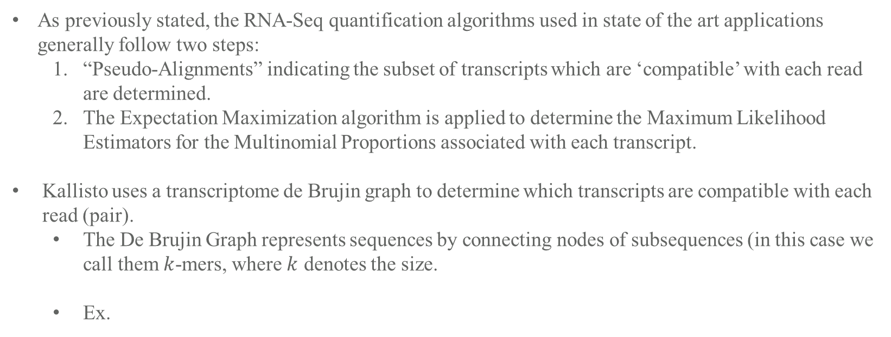
Kallisto: Understanding the Algorithm
As previously stated, the RNA-Seq quantification algorithms used in state of the art applications generally follow two steps:
“Pseudo-Alignments” indicating the subset of transcripts which are ‘compatible’ with each read are determined.
The Expectation Maximization algorithm is applied to determine the Maximum Likelihood Estimators for the Multinomial Proportions associated with each transcript.
Kallisto uses a transcriptome de Brujin graph to determine which transcripts are compatible with each read (pair).
The De Brujin Graph represents sequences by connecting nodes of subsequences (in this case we call them $k$-mers, where $k$ denotes the size.
Ex.
ACC
CCA
CAT
ATA
TAC
ACC
ACC
TAC
CCA
ACCATACC
ATA
Starting Sequence
CAT
3-mers
Simple De Brujin Graph

Slide 13
Kallisto: Understanding the Algorithm (Pseudo-Alignment)
ACC
CCA
CAT
ATA
TAC
ACC
ACC
TAC
CCA
ACCATACC
ATA
Starting Sequence
CAT
3-mers
Simple De Brujin Graph
Extending the De Brujin procedure to representing transcriptomes can be accomplished by adding “colors” or categorical weights to the edges of the De Brujin graph representing the particular transcript of alignment.
ACC
CCA
CCG
CAT
CGT
ATA
GTA
TAC
ACC
ACC
TAC
CCA
CCG
ACCATACC
ACCGTACC
ATA
CAT
GTA
CGT
Starting Transcriptome
3-mers
Simple De Brujin Graph

Slide 14
Kallisto: Understanding the Algorithm (Pseudo-Alignment)
Given a new set of reads, the $k$-mers can be determined, and then using the De Brujin Graph Transcriptome, the pseudo-alignments of a set of reads can be determined.
T1: ACCATACC
T2: ACCGTACC
ACC
CCA
ACC
TAC
CCA
R1: 10
R2: 01
R3: 11
R1: ACCA
R2: ACCG
R3: TACC
ACC
CCG
CCG
ATA
CAT
TAC
CAT
GTA
CGT
Sequencing Reads
3-mers
Comparison of 3-mers from reads to color DBG transcriptome allows the determination of compatibility counts.
https://tinyheero.github.io/2015/09/02/pseudoalignments-kallisto.html

Slide 15
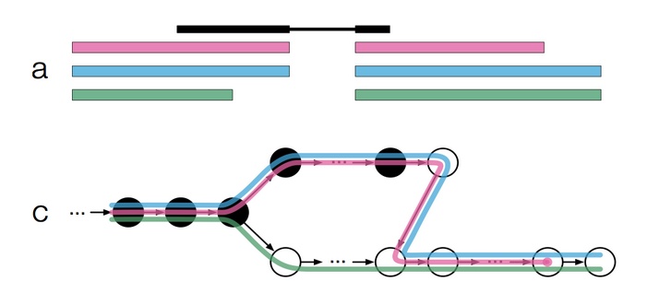
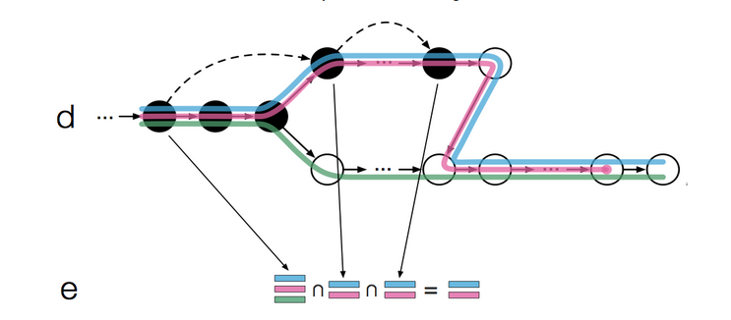
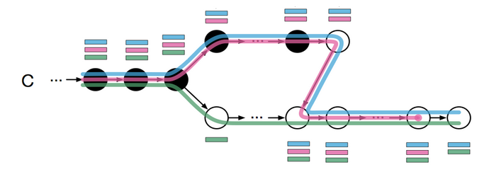
Kallisto Pseudo-Alignment Example Backup
b
This is taken from Fong Chun Chan’s Blog post on “How Pseudoalignments Work in Kallisto.”
https://tinyheero.github.io/2015/09/02/pseudoalignments-kallisto.html

Slide 16
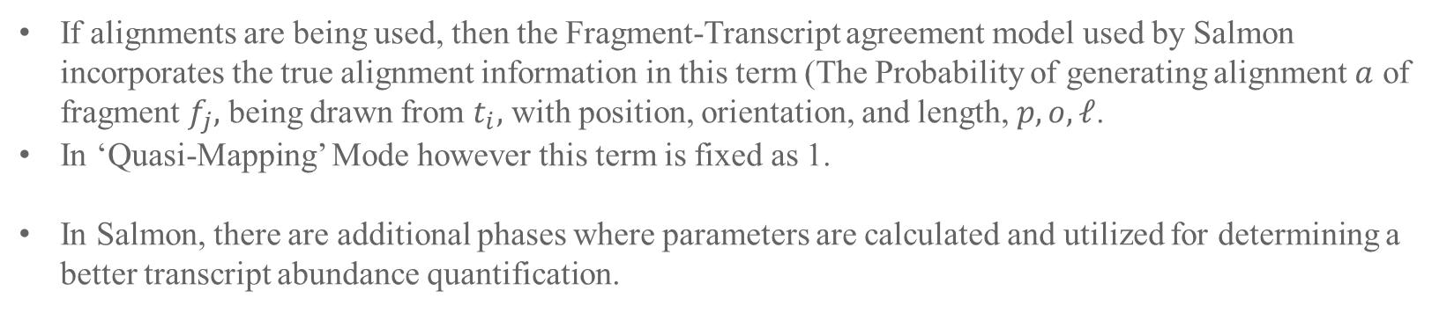
Salmon: Understanding the Algorithm ( Quasi-Mapping)
If alignments are being used, then the Fragment-Transcript agreement model used by Salmon incorporates the true alignment information in this term (The Probability of generating alignment $a$ of fragment $f_{j},$ being drawn from $t_{i},$ with position, orientation, and length, $p,o,ℓ$.
In ‘Quasi-Mapping’ Mode however this term is fixed as 1.
In Salmon, there are additional phases where parameters are calculated and utilized for determining a better transcript abundance quantification.
Patro R, Duggal G, Love MI, Irizarry RA, Kingsford C. Salmon provides fast and bias-aware quantification of transcript expression. Nat Methods. 2017;14(4):417-419. doi:10.1038/nmeth.4197
https://www.ncbi.nlm.nih.gov/pmc/articles/PMC5600148/#FD10

Slide 17
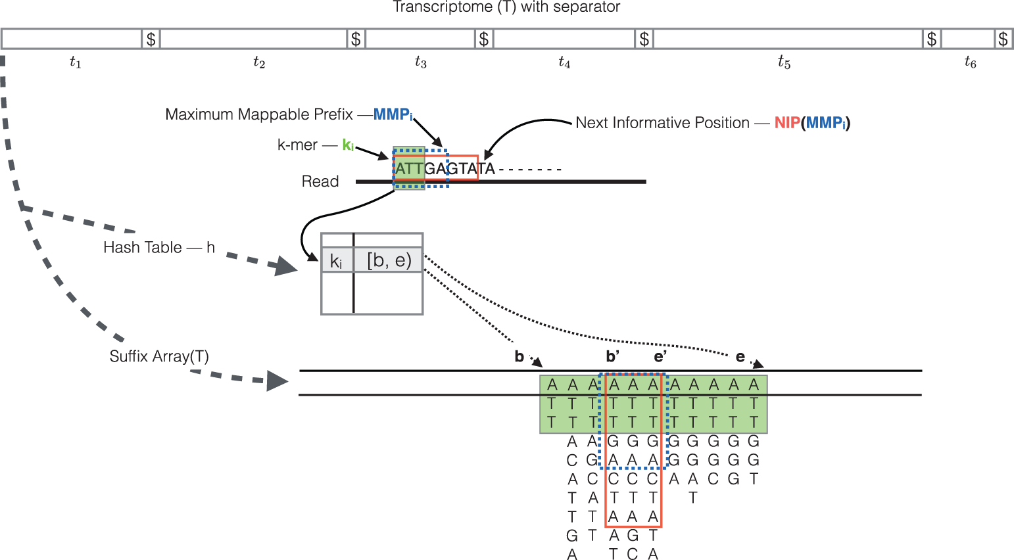
Salmon: Understanding the Algorithm ( Quasi-Mapping)
First a Suffix Array is built for the transcriptome
A K-mer Hash table for indexing into the the suffix array is constructed
Reads are scanned, and when k-mers in the hash table are found, all suffixes matching are extracted from the suffix array
The longest prefix in common among all the suffixes (called the MMP Maximal Matching Prefix) is found.
This is repeated for all kmers, and then the intersection of transcripts in the MMP
The Transcripts which are intersected by the associated MMP are provided as the compatible quasi-mappings
From Paper:
RapMap: a rapid, sensitive and accurate tool for mapping RNA-seq reads to transcriptomes. A. Srivastava, H. Sarkar, N. Gupta, R. Patro. Bioinformatics (2016) 32 (12): i192-i200.
* From Article: Quantification of transcript abundance using Salmon Introduction to bulk RNA-seq
https://hbctraining.github.io/Intro-to-rnaseq-hpc-salmon-flipped/lessons/08_quasi_alignment_salmon.html

Slide 18
Questions about Pseudo-Alignment/Quasi-Mapping?

Slide 19
Break (10 Minutes)

Slide 20
Part 2: Expectation Maximization & Gene Transcript Quantification

Slide 21
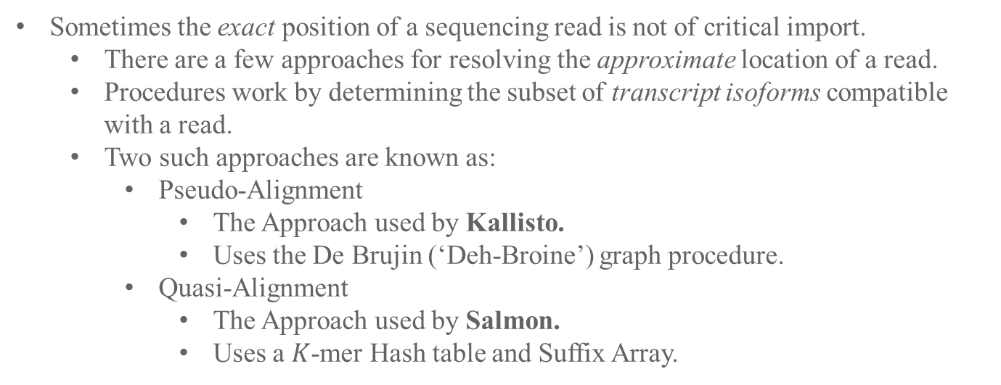
Pseudo/Quasi Alignment in RNA Experiments
Typical ‘DNA-Seq Like’ Experiment
Reads
Sometimes the exact position of a sequencing read is not of critical import.
There are a few approaches for resolving the approximate location of a read.
Procedures work by determining the subset of transcript isoforms compatible with a read.
Two such approaches are known as:
Pseudo-Alignment
The Approach used by Kallisto.
Uses the De Brujin (‘Deh-Broine’) graph procedure.
Quasi-Alignment
The Approach used by Salmon.
Uses a $K$-mer Hash table and Suffix Array.
Reference
Typical ‘RNA-Seq Like’
Experiment
Reads mapped to compatible isoforms in Transcriptome
T1
T2
Expectation
Maximization
T1
T2
T3
T4
3
2
4
1
||||
||||
|||| |
T3
T4
||||
Recall that in most typical sequencing experiments we are dealing with a large collection of shorter subsequences called reads, which we attempt to map to a larger sequence known as the reference.
Resources – Kallisto (Pseudo-alignment)
https://tinyheero.github.io/2015/09/02/pseudoalignments-kallisto.html (Higher Level Overview pseudo alignment)
https://www.youtube.com/watch?v=f-ecmECK7lw (Video Describing how To Build The De Brujin graph)
https://www.nature.com/articles/nbt.2023 (Nature Primer on Using De Brujin Graphs for Genomic Alignments).
Resources – Salmon (Quasi-alignment)
https://hbctraining.github.io/Intro-to-rnaseq-hpc-salmon-flipped/lessons/08_quasi_alignment_salmon.html (Higher Level Overview Quasi-Alignment)
https://academic.oup.com/bioinformatics/article/32/12/i192/2288985?login=true (RapMap Paper and Description).

Slide 22

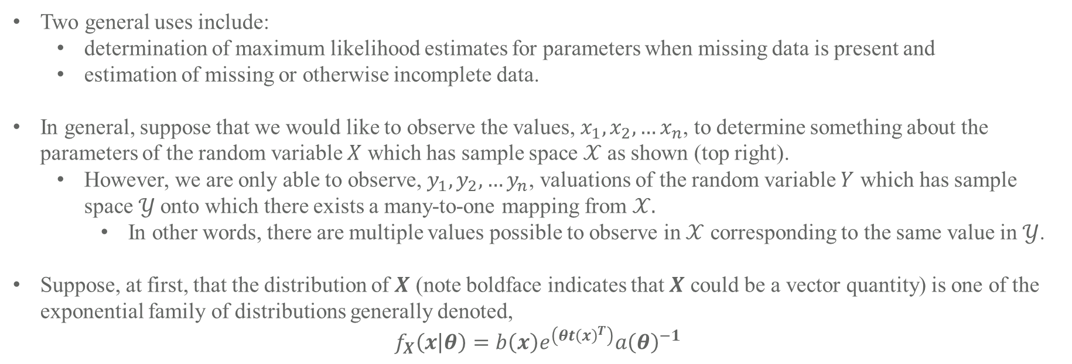
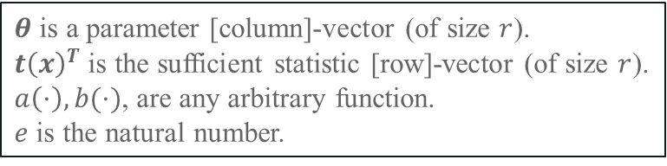

Many-to-one relationship
Expectation Maximization (in general) – Incomplete Data & A Restricted Case
$$𝒳$$
$$𝒴$$
Two general uses include:
determination of maximum likelihood estimates for parameters when missing data is present and
estimation of missing or otherwise incomplete data.
In general, suppose that we would like to observe the values, $x_{1},x_{2},…x_{n}$, to determine something about the parameters of the random variable $X$ which has sample space $𝒳$ as shown (top right).
However, we are only able to observe, $y_{1},y_{2},…y_{n}$, valuations of the random variable $Y$ which has sample space $𝒴$onto which there exists a many-to-one mapping from $𝒳.$
In other words, there are multiple values possible to observe in $𝒳$ corresponding to the same value in $𝒴$.
Suppose, at first, that the distribution of $X$ (note boldface indicates that $X$ could be a vector quantity) is one of the exponential family of distributions generally denoted,
$$f_{X}\left(x | θ\right)=b\left(x\right)e^{\left(θt{\left(x\right)}^{T}\right)}a{\left(θ\right)}^{−1}$$
$θ$ is a parameter [column]-vector (of size $r$).
$t{\left(x\right)}^{T}$ is the sufficient statistic [row]-vector (of size $r$).
$a\left(⋅\right),b(⋅)$, are any arbitrary function.
$e$ is the natural number.
See section II of the Dempster, Laird, Rubin paper mentioned below for more details about natural parameters.
These Expectation Maximization Notes Draw Heavily from “Maximum Likelihood from Incomplete Data via the EM Algorithm” by Dempster Rubin and Laird (https://www.jstor.org/stable/2984875)

Slide 23
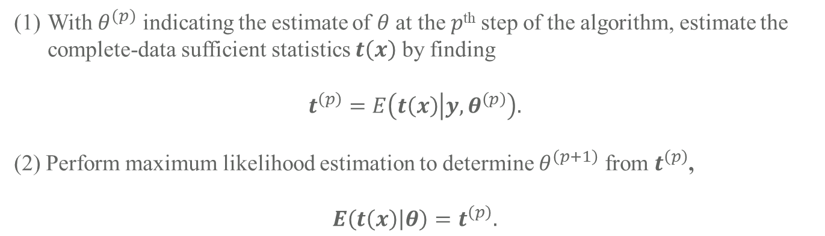
Expectation Maximization (in general) – The Algorithm
The “simple characterization” of the EM algorithm according to Dempster, Laird, and Rubin (DLR77) is:
With $θ^{(p)}$ indicating the estimate of $θ$ at the $p$^{th} step of the algorithm, estimate the complete-data sufficient statistics $t\left(x\right)$ by finding
$$t^{\left(p\right)}=E\left(t\left(x\right) | y,θ^{\left(p\right)}\right).$$
(2) Perform maximum likelihood estimation to determine $θ^{\left(p+1\right)}$ from $t^{\left(p\right)}$,
$$E\left(t\left(x\right) | θ\right)=t^{\left(p\right)}.$$
Proof of convergence to the maximum likelihood value is given the DLR77, as are details regarding further generalizations of the expectation maximization algorithm.
The algorithm is broadly applicable in many cases, and not all of the applications have been discovered yet.
These Expectation Maximization Notes Draw Heavily from “Maximum Likelihood from Incomplete Data via the EM Algorithm” by Dempster Rubin and Laird (https://www.jstor.org/stable/2984875)

Slide 24
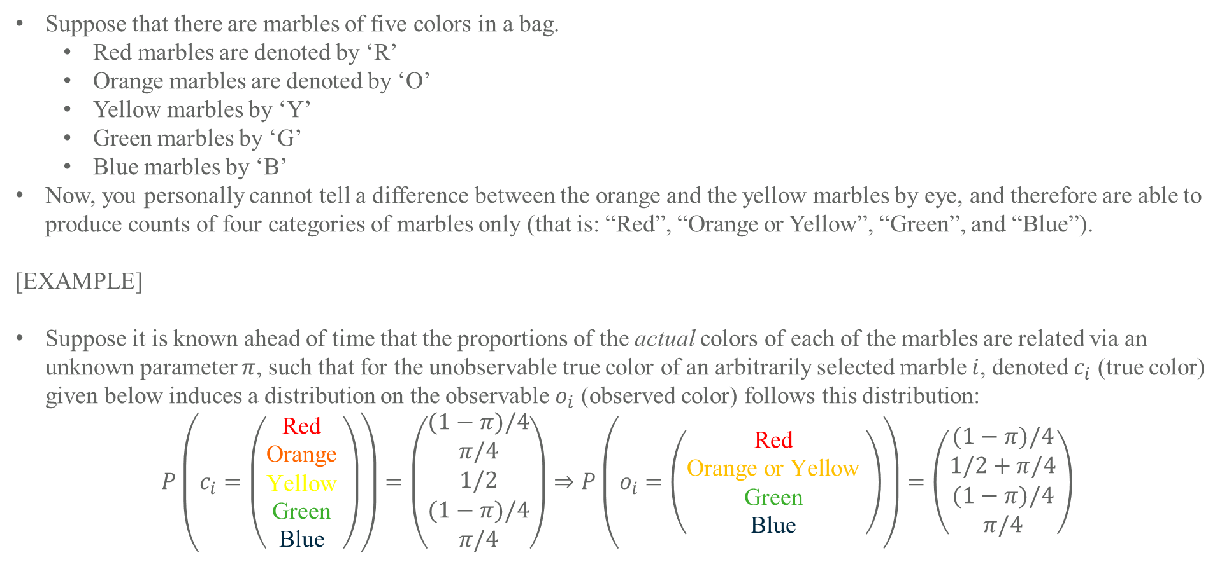
Expectation Maximization (in general) – A Multinomial Example
Suppose that there are marbles of five colors in a bag.
Red marbles are denoted by ‘R’
Orange marbles are denoted by ‘O’
Yellow marbles by ‘Y’
Green marbles by ‘G’
Blue marbles by ‘B’
Now, you personally cannot tell a difference between the orange and the yellow marbles by eye, and therefore are able to produce counts of four categories of marbles only (that is: “Red”, “Orange or Yellow”, “Green”, and “Blue”).
[EXAMPLE]
Suppose it is known ahead of time that the proportions of the actual colors of each of the marbles are related via an unknown parameter $π$, such that for the unobservable true color of an arbitrarily selected marble $i$, denoted $c_{i}$ (true color) given below induces a distribution on the observable $o_{i}$ (observed color) follows this distribution:
$$P\left(c_{i}=\left(\begin{matrix}\text{Red} \\ \text{Orange} \\ \text{Yellow} \\ \text{Green} \\ \text{Blue} \end{matrix}\right)\right)=\left(\begin{matrix}(1−π)/4 \\ π/4 \\ 1/2 \\ (1−π)/4 \\ π/4\end{matrix}\right)⇒P\left(o_{i}=\left(\begin{matrix}\text{Red} \\ \text{Orange} \text{or} \text{Yellow} \\ \text{Green} \\ \text{Blue} \end{matrix}\right)\right)=\left(\begin{matrix}(1−π)/4 \\ 1/2+π/4 \\ (1−π)/4 \\ π/4\end{matrix}\right)$$
Red
Red
Orange
Orange or Yellow
Yellow
Green
Green
Blue
Blue
These Expectation Maximization Notes Draw Heavily from “Maximum Likelihood from Incomplete Data via the EM Algorithm” by Dempster Rubin and Laird (https://www.jstor.org/stable/2984875)

Slide 25
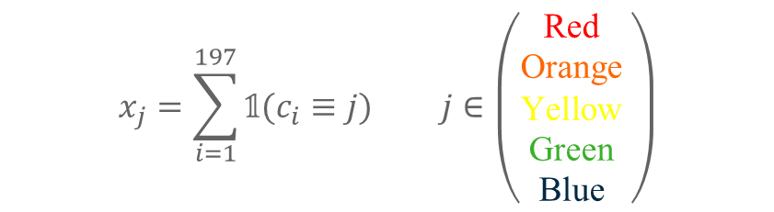
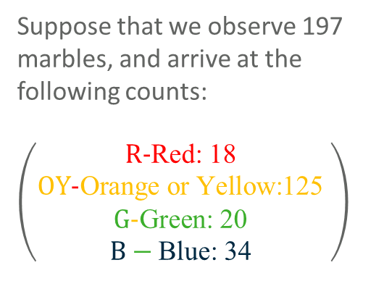
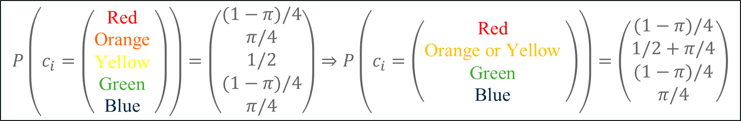
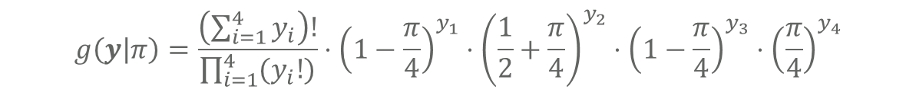
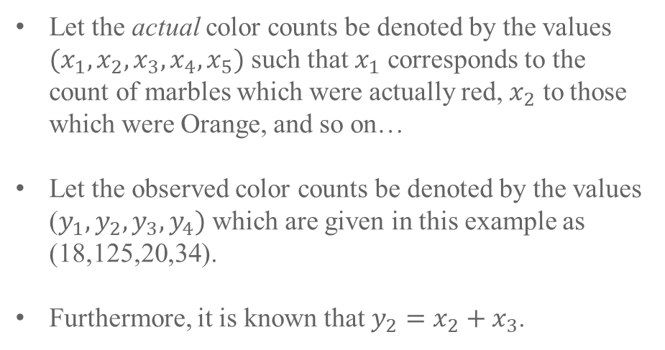
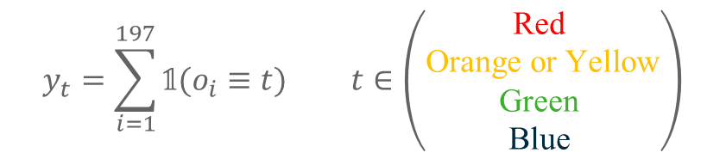
Expectation Maximization (in general) – A Multinomial Example (Continued)
Suppose that we observe 197 marbles, and arrive at the following counts:
$\left(\begin{matrix}\text{R}\text{−}\text{Red}\text{: 18} \\ \text{OY}\text{−}\text{Orange} \text{or} \text{Yellow}\text{:125} \\ \text{G}\text{−}\text{Green}\text{: 20} \\ B−\text{Blue}\text{: 34} \end{matrix}\right)$
$$P\left(c_{i}=\left(\begin{matrix}\text{Red} \\ \text{Orange} \\ \text{Yellow} \\ \text{Green} \\ \text{Blue} \end{matrix}\right)\right)=\left(\begin{matrix}(1−π)/4 \\ π/4 \\ 1/2 \\ (1−π)/4 \\ π/4\end{matrix}\right)⇒P\left(c_{i}=\left(\begin{matrix}\text{Red} \\ \text{Orange} \text{or} \text{Yellow} \\ \text{Green} \\ \text{Blue} \end{matrix}\right)\right)=\left(\begin{matrix}(1−π)/4 \\ 1/2+π/4 \\ (1−π)/4 \\ π/4\end{matrix}\right)$$
$$x_{j}=\sum_{i=1}^{197}{𝟙(c_{i}≡j)} j∈\left(\begin{matrix}\text{Red} \\ \text{Orange} \\ \text{Yellow} \\ \text{Green} \\ \text{Blue} \end{matrix}\right)$$
Let the actual color counts be denoted by the values $(x_{1},x_{2},x_{3},x_{4},x_{5})$ such that $x_{1}$ corresponds to the count of marbles which were actually red, $x_{2}$ to those which were Orange, and so on…
Let the observed color counts be denoted by the values ($y_{1},y_{2},y_{3},y_{4})$ which are given in this example as (18,125,20,34).
Furthermore, it is known that $y_{2}=x_{2}+x_{3}$.
$$y_{t}=\sum_{i=1}^{197}{𝟙(o_{i}≡t)} t∈\left(\begin{matrix}\text{Red} \\ \text{Orange} \text{or} \text{Yellow} \\ \text{Green} \\ \text{Blue} \end{matrix}\right)$$
The Likelihood on $π$ for the full data can be expressed as:
$$f\left(x | π\right)=\frac{\left(\sum_{i=1}^{5}{x_{i}}\right)!}{\prod_{i=1}^{5}{{(x}_{i}!)}}⋅{\left(\frac{1−π}{4}\right)}^{x_{1}}⋅{\left(\frac{π}{4}\right)}^{x_{2}}⋅{\left(\frac{1}{2}\right)}^{x_{3}}⋅{\left(\frac{1−π}{4}\right)}^{x_{4}}⋅{\left(\frac{π}{4}\right)}^{x_{5}}$$
The coarsened/incomplete Likelihood on $π$ for the full data can be expressed as:
$$g\left(y | π\right)=\frac{\left(\sum_{i=1}^{4}{y_{i}}\right)!}{\prod_{i=1}^{4}{{(y}_{i}!)}}⋅{\left(1−\frac{π}{4}\right)}^{y_{1}}⋅{\left(\frac{1}{2}+\frac{π}{4}\right)}^{y_{2}}⋅{\left(1−\frac{π}{4}\right)}^{y_{3}}⋅{\left(\frac{π}{4}\right)}^{y_{4}}$$
DLR77 (https://www.jstor.org/stable/2984875)

Slide 26
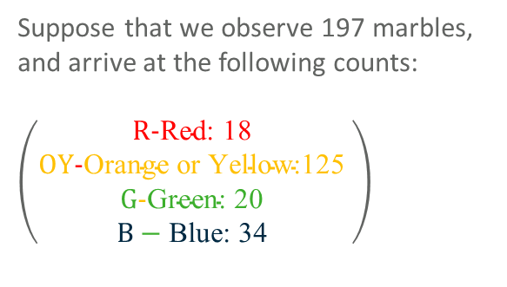
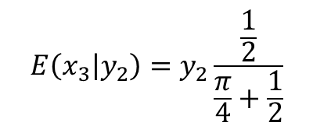
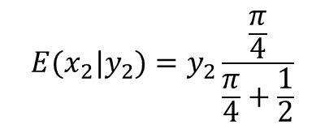


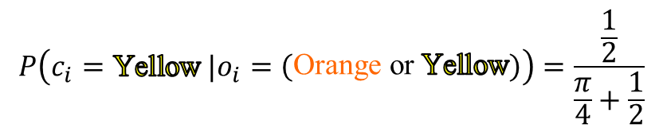
Expectation Maximization (in general) – A Multinomial Example (E-Step)
Clearly, due to the fact that a marble cannot actually be two colors simultaneously, there is no probability that any marble is truly both orange and yellow at the same time, therefore we may express the probability that a marble is orange or yellow as follows:
$$P\left(o_{i}=\left(\begin{matrix}\text{Orange} \text{or} \text{Yellow}\end{matrix}\right)\right)=P\left(c_{i}∈\left(\begin{matrix}\text{Orange} \\ \text{Yellow}\end{matrix}\right)\right)=P\left(c_{i}=\text{Orange}\right)+P\left(c_{i}=\text{Yellow}\right)−P\left(c_{i}=\text{Yellow} \&{ c}_{i}=\text{Orange}\right)$$
$$=\frac{π}{4}+\frac{1}{2}$$
$$=P\left(c_{i}=\text{Orange}\right)+P\left(c_{i}=\text{Yellow}\right)−0$$
From here we can derive the expression for the maximum likelihood estimates of the unobserved counts for orange and yellow marbles ${(x}_{2},x_{3})$ in terms of the observed count of “orange or yellow” marbles ($y_{2}$).
$P\left(c_{i}=\text{Orange} |o_{i}=\left(\begin{matrix}\text{Orange} \text{or} \text{Yellow}\end{matrix}\right)\right)=\frac{P\left(o_{i}=\left(\begin{matrix}\text{Orange} \text{or} \text{Yellow}\end{matrix}\right) \&{ c}_{i}=\text{Orange}\right)}{P(o_{i}=\left(\begin{matrix}\text{Orange} \text{or} \text{Yellow}\end{matrix}\right))}=\frac{P(c_{i}=\text{Orange}\text{)}}{P\left(o_{i}=\left(\begin{matrix}\text{Orange} \text{or} \text{Yellow}\end{matrix}\right)\right) }=\frac{\frac{π}{4}}{\frac{π}{4}+\frac{1}{2}}$
$$P\left(c_{i}=\text{Yellow} |o_{i}=\left(\begin{matrix}\text{Orange} \text{or} \text{Yellow}\end{matrix}\right)\right)=\frac{\frac{1}{2}}{\frac{π}{4}+\frac{1}{2}}$$
Therefore the conditional expectation of $x_{2}$ and $x_{3}$ are:
$$E(x_{2}|y_{2})=y_{2}\frac{\frac{π}{4}}{\frac{π}{4}+\frac{1}{2}}$$
$$E\left(x_{3} | y_{2}\right)=y_{2}\frac{\frac{1}{2}}{\frac{π}{4}+\frac{1}{2}}$$
Suppose that we observe 197 marbles, and arrive at the following counts:
$\left(\begin{matrix}\text{R}\text{−}\text{Red}\text{: 18 } \\ \text{OY}\text{−}\text{Orange} \text{or} \text{Yellow}\text{:125 } \\ \text{G}\text{−}\text{Green}\text{: 20 } \\ B−\text{Blue}\text{: 34 }\end{matrix}\right)$
- and -
These Expectation Maximization Notes Draw Heavily from “Maximum Likelihood from Incomplete Data via the EM Algorithm” by Dempster Rubin and Laird (https://www.jstor.org/stable/2984875)

Slide 27
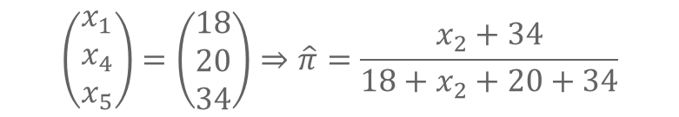
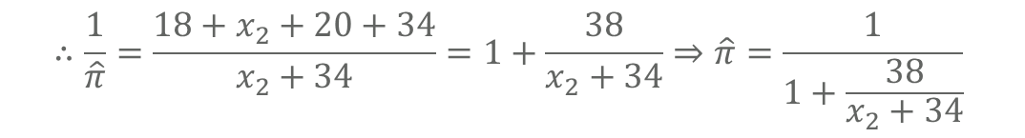
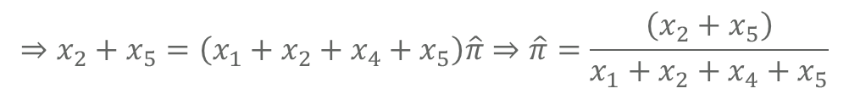
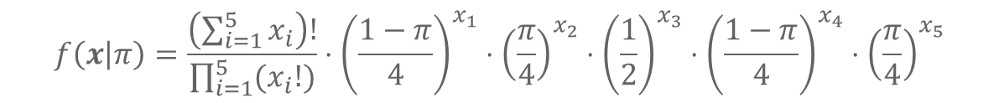
Expectation Maximization (in general) – A Multinomial Example (M-Step)
$$⇒x_{1}+x_{4}=x_{2}\hat{π}+x_{5}\hat{π}+x_{1}\hat{π}+x_{4}\hat{π}$$
Recall that the full likelihood for the multinomial distribution was given by:
$$f\left(x | π\right)=\frac{\left(\sum_{i=1}^{5}{x_{i}}\right)!}{\prod_{i=1}^{5}{{(x}_{i}!)}}⋅{\left(\frac{1−π}{4}\right)}^{x_{1}}⋅{\left(\frac{π}{4}\right)}^{x_{2}}⋅{\left(\frac{1}{2}\right)}^{x_{3}}⋅{\left(\frac{1−π}{4}\right)}^{x_{4}}⋅{\left(\frac{π}{4}\right)}^{x_{5}}$$
$$⇒\log{L(π|x)}=\log{\frac{\left(\sum_{i=1}^{5}{x_{i}}\right)!}{\prod_{i=1}^{5}{{(x}_{i}!)}}}+x_{1}\log\left(\frac{\left(1−π\right)}{4}\right)+x_{2}\log\left(\frac{π}{4}\right)+x_{3}\log\left(\frac{1}{2}\right)+x_{4}\log\left(\frac{\left(1−π\right)}{4}\right)+x_{5}\log\left(\frac{π}{4}\right)$$
In this example, only $x_{2}$ and $x_{3}$ are unobservable, the rest are known:
$$⇒\frac{∂\log{L(π|x)}}{∂ π}=x_{1}\left(\frac{4}{1−π}\right)\left(−\frac{1}{4}\right)+x_{2}\left(\frac{4}{π}\right)\left(\frac{1}{4}\right)+x_{4}\left(\frac{4}{1−π}\right)\left(−\frac{1}{4}\right)+x_{5}\left(\frac{4}{π}\right)\left(\frac{1}{4}\right)=\frac{x_{1}}{π−1}+\frac{x_{2}}{π}+\frac{x_{4}}{π−1}+\frac{x_{5}}{π}$$
$$⇒\frac{x_{1}}{\hat{π}−1}+\frac{x_{2}}{\hat{π}}+\frac{x_{4}}{\hat{π}−1}+\frac{x_{5}}{\hat{π}}=0⇒\left(x_{2}+x_{5}\right)\left(1−\hat{π}\right)=\left(x_{1}+x_{4}\right)\hat{π}⇒x_{2}+x_{5}−x_{2}\hat{π}−x_{5}\hat{π}=x_{1}\hat{π}+x_{4}\hat{π}$$
$$⇒x_{2}+x_{5}=\left(x_{1}+x_{2}+x_{4}+x_{5}\right)\hat{π}⇒\hat{π}=\frac{\left(x_{2}+x_{5}\right)}{x_{1}+x_{2}+x_{4}+x_{5}}$$
Suppose that we observe 197 marbles, and arrive at the following counts:
$\left(\begin{matrix}\text{R}\text{−}\text{Red}\text{: 18 } \\ \text{OY}\text{−}\text{Orange} \text{or} \text{Yellow}\text{:125 } \\ \text{G}\text{−}\text{Green}\text{: 20 } \\ B−\text{Blue}\text{: 34 }\end{matrix}\right)$
$$⇒−x_{1}\hat{π}−x_{4}\hat{π}+x_{1}+x_{4}=x_{2}\hat{π}+x_{5}\hat{π}$$
$$\left(\begin{matrix}x_{1} \\ x_{4} \\ x_{5}\end{matrix}\right)=\left(\begin{matrix}18 \\ 20 \\ 34\end{matrix}\right)⇒\hat{π}=\frac{x_{2}+34}{18+x_{2}+20+34}$$
$$⇒x_{1}+x_{4}=x_{2}\hat{π}+x_{5}\hat{π}+x_{1}\hat{π}+x_{4}\hat{π}$$
$$∴\frac{1}{\hat{π}}=\frac{18+x_{2}+20+34}{x_{2}+34}=1+\frac{38}{x_{2}+34}⇒\hat{π}=\frac{1}{1+\frac{38}{x_{2}+34}}$$

Slide 28
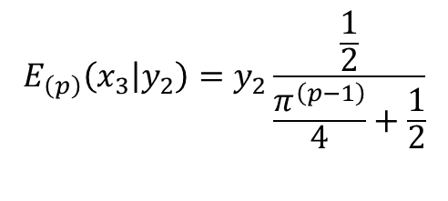

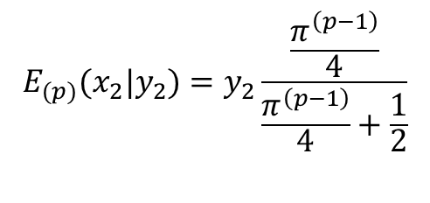

Expectation Maximization (in general) – A Multinomial Example (Iteration)
Taking the conditional expectations for the computation of $x_{2}$ and $x_{3}$ will depend on a particular estimation of $π$, an initial estimate ($π^{\left(0\right)}$) must be supplied to the algorithm to start the procedure, then conditional expectations for the missing (coarsened) data at the $p$^{th} step (where $p∈ \{1,2,…\}$) is given by:
$$E_{(p)}(x_{2}|y_{2})=y_{2}\frac{\frac{π^{\left(p−1\right)}}{4}}{\frac{π^{\left(p−1\right)}}{4}+\frac{1}{2}}$$
$$E_{\left(p\right)}\left(x_{3} | y_{2}\right)=y_{2}\frac{\frac{1}{2}}{\frac{π^{\left(p−1\right)}}{4}+\frac{1}{2}}$$
[E – Step]
- and -
$$\hat{π^{\left(p\right)}}=\frac{1}{1+\frac{38}{E_{(p)}(x_{2}|y_{2})+34}}$$
[M – Step]
Convergence Criteria:
Generally we use relative convergence criteria (when the change in the parameters from step $p$ to step $p+1$ falls below a relative tolerance $ε_{R}$) to determine when to stop iterating, for instance, the iteration will continue until:
$${\left(\frac{1}{1+\frac{38}{E_{\left(p\right)}\left(x_{2} | y_{2}\right)+34}}−\frac{1}{1+\frac{38}{E_{\left(p−1\right)}\left(x_{2} | y_{2}\right)+34}}\right)}^{2}≤ε_{R}$$
[Convergence]

Slide 29
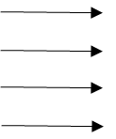













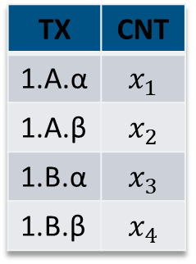









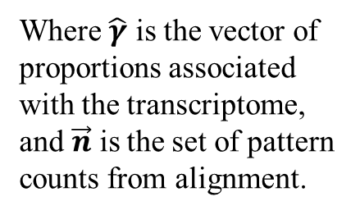
Expectation Maximization (Genetic Abundance Estimation)
We observe $N_{r}$ RNA-seq reads from an experiment involving a transcriptome of size $T$.
Each of the $N_{r}$ reads came specifically from only one of the $T$ categories.
True Abundances
In-Vivo RNA
Aligned Reads allow counts of compatible transcript patterns to be captured.
Gene 1
TX | CNT
1.A.α | $$x_{1}$$
1.A.β | $$x_{2}$$
1.B.α | $$x_{3}$$
1.B.β | $$x_{4}$$
Transcript A
Sampled RNA
Allele $α$
Pseudo/Quasi/Fully Aligned RNA Read Pattern Counts
Allele $β$
1.a.α
1.b.α
$$n_{1aα}$$
$$n_{1bα}$$
Transcript B
1.a.β
$$n_{1a⋅}$$
$$n_{1⋅α}$$
$$n_{1b⋅}$$
1.b.β
Allele $α$
RNA reads are sampled from the original subject’s genetic material.
Allele $β$
$$n_{1bβ}$$
$$n_{1aβ}$$
We are interested in the vector of true abundances, and estimate these through EM.
$$…$$
Gene 2
Expectation Maximization
$$n_{⋅⋅⋅}$$
$$n_{1b⋅1aα}$$
$$…$$
$$n_{1a⋅1bα}$$
$$n_{1bα1aβ}$$
$$n_{1⋅β}$$
$$n_{1bβ1aα}$$
Genes, transcripts, and alleles are initially differentially expressed in a subject of interest.
[E-Step] $E\left(\vec{x} \right|\vec{ n})$
[M-Step] $\frac{∂L\left(\hat{γ} | \vec{x}\right)}{∂\hat{γ}}=0$
$$n_{1b⋅1aβ}$$
$$n_{1a⋅1bβ}$$
Where $\hat{γ}$ is the vector of proportions associated with the transcriptome, and $\vec{n}$ is the set of pattern counts from alignment.

Slide 30
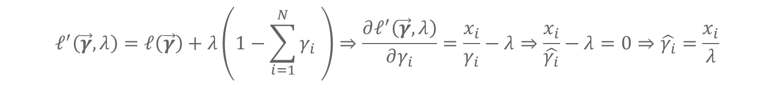
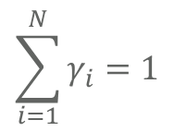
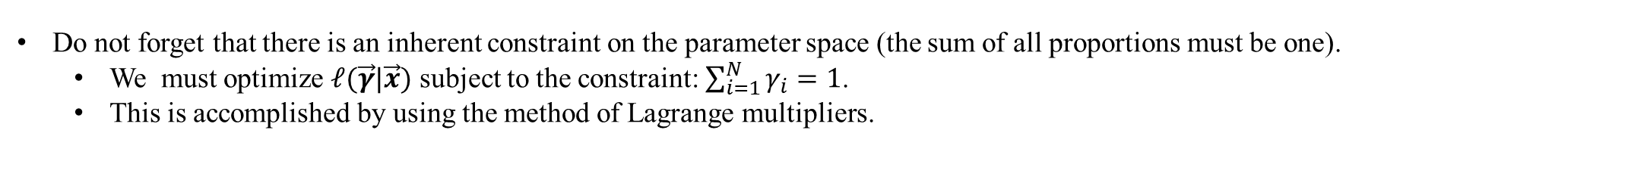
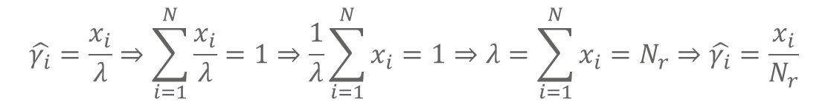
Expectation Maximization (Genetic Abundance Estimation) [M-Step]
Clearly, the distribution of the reads among their true transcript sources can be modeled as multinomial.
The probability distribution of the count vector of the true abundances, $\vec{X}$, is
$$\operatorname{Pr}\left(\vec{X}=\vec{x}\right)=\frac{\left(\sum_{i=1}^{N}{x_{i}}\right)!}{\prod_{i=1}^{N}{\left(x_{i}\right)!}}\prod_{i=1}^{N}{γ_{i}^{x_{i}}}$$
This probability distribution function doubles as the Likelihood for the parameter vector $\vec{γ}$ under the observed data $\vec{x}$.
$$L\left(\vec{γ} | \vec{x}\right)=\frac{\left(\sum_{i=1}^{N}{x_{i}}\right)!}{\prod_{i=1}^{N}{\left(x_{i}\right)!}}\prod_{i=1}^{N}{γ_{i}^{x_{i}}}⇒ℓ\left(\vec{γ} | \vec{x}\right)=\log{\frac{\left(\sum_{i=1}^{N}{x_{i}}\right)!}{\prod_{i=1}^{N}{\left(x_{i}\right)!}}}+\sum_{i=1}^{N}{x_{i}}\log{γ_{i}}⇒\frac{∂ℓ\left(\vec{γ} | \vec{x}\right)}{∂γ_{i}}=\frac{x_{i}}{γ_{i}}$$
$$\sum_{i=1}^{N}{γ_{i}}=1$$
Do not forget that there is an inherent constraint on the parameter space (the sum of all proportions must be one).
We must optimize $ℓ(\vec{γ}|\vec{x})$ subject to the constraint: $\sum_{i=1}^{N}{γ_{i}}=1$.
This is accomplished by using the method of Lagrange multipliers.
$$ℓ^{′}\left(\vec{γ},λ\right)=ℓ\left(\vec{γ}\right)+λ\left(1−\sum_{i=1}^{N}{γ_{i} }\right)⇒\frac{∂ℓ^{′}\left(\vec{γ},λ\right)}{∂γ_{i}}=\frac{x_{i}}{γ_{i}}−λ⇒\frac{x_{i}}{\hat{γ_{i}}}−λ=0⇒\hat{γ_{i}}=\frac{x_{i}}{λ}$$
$$\hat{γ_{i}}=\frac{x_{i}}{λ}⇒\sum_{i=1}^{N}{\frac{x_{i}}{λ}}=1⇒\frac{1}{λ}\sum_{i=1}^{N}{x_{i}}=1⇒λ=\sum_{i=1}^{N}{x_{i}}=N_{r}⇒\hat{γ_{i}}=\frac{x_{i}}{N_{r}}$$

Slide 31
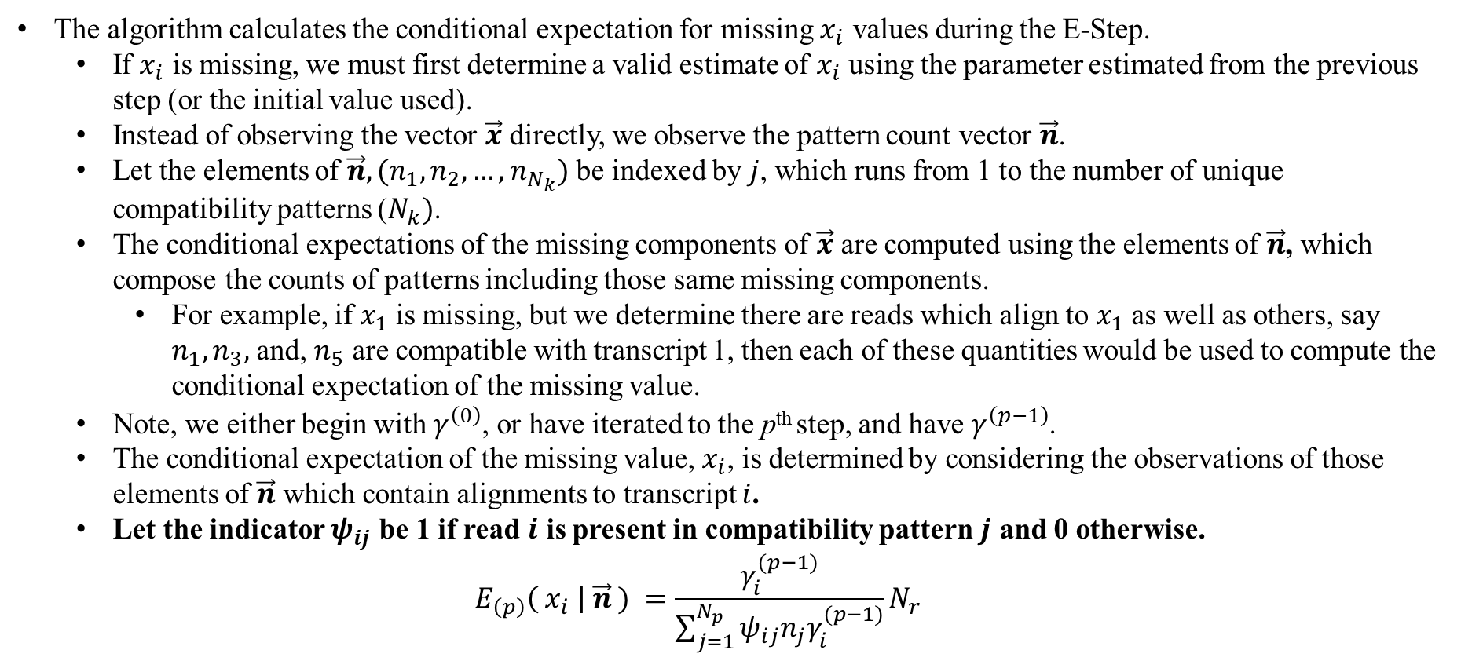
Expectation Maximization (Genetic Abundance Estimation) [E-Step]
The algorithm calculates the conditional expectation for missing $x_{i}$ values during the E-Step.
If $x_{i}$ is missing, we must first determine a valid estimate of $x_{i}$ using the parameter estimated from the previous step (or the initial value used).
Instead of observing the vector $\vec{x}$ directly, we observe the pattern count vector $\vec{n}$.
Let the elements of $\vec{n},(n_{1},n_{2},…,n_{N_{k}})$ be indexed by $j$, which runs from 1 to the number of unique compatibility patterns ($N_{k})$.
The conditional expectations of the missing components of $\vec{x}$ are computed using the elements of $\vec{n}$, which compose the counts of patterns including those same missing components.
For example, if $x_{1}$ is missing, but we determine there are reads which align to $x_{1}$ as well as others, say $n_{1},n_{3},$ and, $n_{5}$ are compatible with transcript 1, then each of these quantities would be used to compute the conditional expectation of the missing value.
Note, we either begin with $γ^{\left(0\right)}$, or have iterated to the p^{th} step, and have $γ^{\left(p−1\right)}$.
The conditional expectation of the missing value, $x_{i}$, is determined by considering the observations of those elements of $\vec{n}$ which contain alignments to transcript $i$.
Let the indicator $ψ_{ij}$ be 1 if read $i$ is present in compatibility pattern $j$ and 0 otherwise.
$$E_{\left(p\right)}\left( x_{i} \right| \vec{n} ) =\frac{γ_{i}^{(p−1)}}{\sum_{j=1}^{N_{p}}{ψ_{ij}n_{j}γ_{i}^{(p−1)}}}N_{r}$$

Slide 32
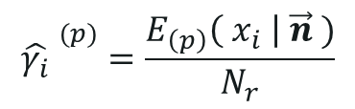
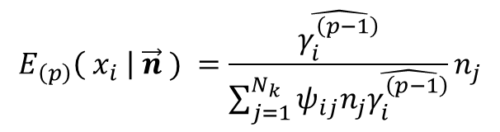

Expectation Maximization (Genetic Abundance Estimation)
The EM algorithm amounts to applying these two operations in alternative order until there is convergence in the parameter vector.
$$E_{\left(p\right)}\left( x_{i} \right| \vec{n} ) =\frac{\hat{γ_{i}^{\left(p−1\right)}}}{\sum_{j=1}^{N_{k}}{ψ_{ij}n_{j}\hat{γ_{i}^{\left(p−1\right)}}}}n_{j}$$
[E-Step]
$$\hat{γ_{i}} ^{(p)}=\frac{E_{\left(p\right)}\left( x_{i} \right| \vec{n} )}{N_{r}}$$
[M-Step]
The EM Algorithm will achieve convergence when the change from step $p−1$ to $p$ is below some user selected relative tolerance $ε_{r}$.
[Convergence Criteria]
$$\hat{γ_{i}} ^{(p)}−\hat{γ_{i}} ^{\left(p−1\right)}≤ε_{r}$$
Note the Expectation Maximization algorithm for Multinomial count data (as above) can be applied in a general case. This algorithm is implemented in multiple software packages available for use, but we have created a general version (For a copy, please request via email at this stage).

Slide 33

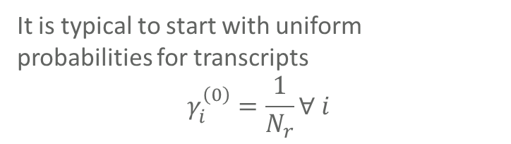
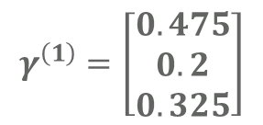

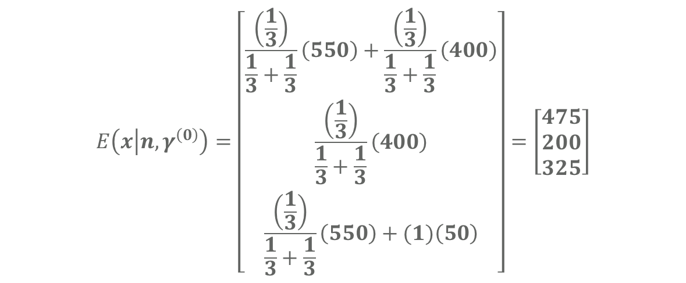
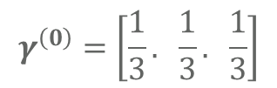
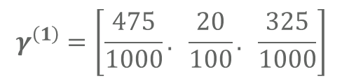


Expectation Maximization (Multinomial algorithm example)
E Step (1)
$$γ^{\left(0\right)}=\left[\frac{1}{3}. \frac{1}{3}. \frac{1}{3}\right]$$
Suppose we have true abundances
Transcript 1 : 500 (0.5)
Transcript 2 : 200 (0.2)
Transcript 3 : 300 (0.3)
But that we can only observe whether reads are in the following:
(T1,T3): 300+250 = 550
(T1,T2): 200+200 = 400
(T3): 50 = 50
$$E\left(x | n,γ^{\left(0\right)}\right)=\left[\begin{matrix}\frac{\left(\frac{1}{3}\right)}{\frac{1}{3}+\frac{1}{3}}\left(550\right)+\frac{\left(\frac{1}{3}\right)}{\frac{1}{3}+\frac{1}{3}}\left(400\right) \\ \frac{\left(\frac{1}{3}\right)}{\frac{1}{3}+\frac{1}{3}}\left(400\right) \\ \frac{\left(\frac{1}{3}\right)}{\frac{1}{3}+\frac{1}{3}}\left(550\right)+(1)\left(50\right)\end{matrix}\right]=\left[\begin{matrix}475 \\ 200 \\ 325\end{matrix}\right]$$
$$\left[\begin{matrix}550 \\ 400 \\ 50\end{matrix}\right]=n$$
$$\left[\begin{matrix}1 & 0 & 1 \\ 1 & 1 & 0 \\ 0 & 0 & 1\end{matrix}\right]$$
It is typical to start with uniform probabilities for transcripts
$$γ_{i}^{\left(0\right)}=\frac{1}{N_{r}}∀ i$$
$$γ^{\left(1\right)}=\left[\frac{475}{1000}. \frac{20}{100}. \frac{325}{1000}\right]$$
$$γ^{\left(1\right)}=\left[\begin{matrix}0.475 \\ 0.2 \\ 0.325\end{matrix}\right]$$
$$\left[\begin{matrix}550 \\ 400 \\ 50\end{matrix}\right]=n$$
$$\left[\begin{matrix}1 & 0 & 1 \\ 1 & 1 & 0 \\ 0 & 0 & 1\end{matrix}\right]$$
M Step (1)

Slide 34
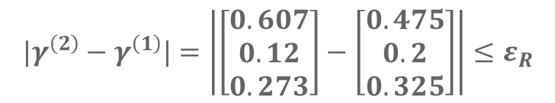
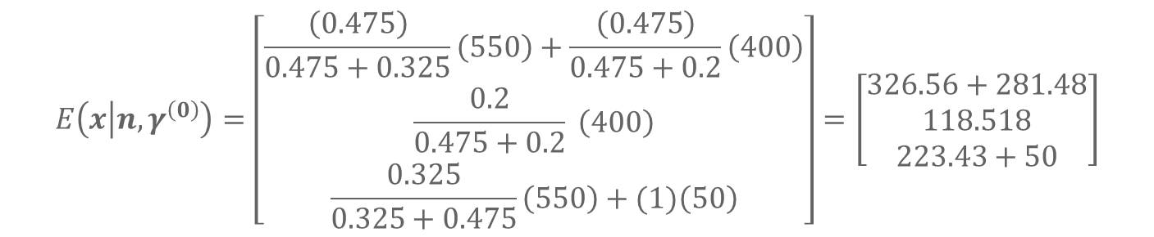

Expectation Maximization (Multinomial algorithm example)
$$E\left(x | n,γ^{\left(0\right)}\right)=\left[\begin{matrix}\frac{\left(0.475\right)}{0.475+0.325}\left(550\right)+\frac{\left(0.475\right)}{0.475+0.2}\left(400\right) \\ \frac{0.2}{0.475+0.2} \left(400\right) \\ \frac{0.325}{0.325+0.475}\left(550\right)+(1)\left(50\right)\end{matrix}\right]=\left[\begin{matrix}326.56+281.48 \\ 118.518 \\ 223.43+50\end{matrix}\right]$$
Suppose we have true abundances
Transcript 1 : 500 (0.5)
Transcript 2 : 200 (0.2)
Transcript 3 : 300 (0.3)
But that we can only observe whether reads are in the following:
(T1,T3): 300+250 = 550
(T1,T2): 200+200 = 400
(T3): 50 = 50
M Step (2)
E Step (2)
$$γ^{\left(2\right)}=\left[\begin{matrix}0.607 \\ 0.12 \\ 0.273\end{matrix}\right]$$
It is typical to start with uniform probabilities for transcripts
$$γ_{i}^{\left(0\right)}=\frac{1}{N_{r}}∀ i$$
$$γ^{\left(1\right)}=\left[\frac{475}{1000}. \frac{20}{100}. \frac{325}{1000}\right]$$
Converged?
$$\left[\begin{matrix}550 \\ 400 \\ 50\end{matrix}\right]=n$$
$$|γ^{\left(2\right)}−γ^{\left(1\right)}|=\left|\left[\begin{matrix}0.607 \\ 0.12 \\ 0.273\end{matrix}\right]−\left[\begin{matrix}0.475 \\ 0.2 \\ 0.325\end{matrix}\right]\right|≤ε_{R}$$
$$\left[\begin{matrix}1 & 0 & 1 \\ 1 & 1 & 0 \\ 0 & 0 & 1\end{matrix}\right]$$

Slide 35
Questions about Expectation Maximization?

Slide 36
Break (10 Minutes)

Slide 37
Part 3: Genetic Transcript Abundance Quantification Software

Slide 38
Software for Genetic Abundance Quantification Salmon & Kallisto
In order to quantify the true abundances of transcripts within a given genomic RNA-Seq sample, we use the Expectation Maximization algorithm following pseudo or quasi read alignment.
Two packages which implement this approach are Salmon and Kallisto
Salmon was developed by Rob Patro, Geet Duggal, Michael Love, Rafael Irizarry, and Carl Kingsford and published in 2017. (https://www.ncbi.nlm.nih.gov/pmc/articles/PMC5600148/)
Kallisto was developed by Nicolas L. Bray, Harold Pimentel, Páll Melsted, and Lior Pachter and published in 2016. (https://www.nature.com/articles/nbt.3519/ )
RSEM (RNA-Seq Expectation Maximization) was an earlier package which implemented expectation maximization on the incomplete/missing compatibility patterns:
Li B, Dewey CN. RSEM: accurate transcript quantification from RNA-Seq data with or without a reference genome. BMC Bioinformatics. 2011;12:323. Published 2011 Aug 4. doi:10.1186/1471-2105-12-323
Logo from SALMON website.
Image from Kallisto website.

Slide 39
Genetic Transcript Abundance Software Kallisto & Salmon
Today, just follow along on the screen with me, tomorrow we will work through getting Kallisto and Salmon on your personal device, and working through some example problems with them together.
In order to run Kallisto and Salmon, you first need to have a transcriptome in the FASTA format (from which the sequencing reads file of interest is taken)
Note if you do not have a transcriptome file, you might need to produce one by first parsing GTF/SNP/ or another Variant Call Format like file, and the reference sequence to which it corresponds.
For example, we created an RNA-Seq read simulator which will allow for us to produce a transcriptome file for GTF/SNP/FASTA (reference) files.
In this short demonstration We will use an example transcriptome from a subset of genes on human chromosome 22.

Slide 40
Genetic Transcript Abundance Software Kallisto & Salmon
To access the help for either Salmon or Kallisto, you can use:
kallisto
Salmon -h
kallisto 0.46.0
Usage: kallisto <CMD> [arguments] ..
Where <CMD> can be one of:
index Builds a kallisto index
quant Runs the quantification algorithm
bus Generate BUS files for single-cell data
pseudo Runs the pseudoalignment step
merge Merges several batch runs
h5dump Converts HDF5-formatted results to plaintext
inspect Inspects and gives information about an index
version Prints version information
cite Prints citation information
Running kallisto <CMD> without arguments prints usage information for <CMD>
salmon v1.8.0
Usage: salmon -h|--help or
salmon -v|--version or
salmon -c|--cite or
salmon [--no-version-check] <COMMAND> [-h | options]
Commands:
index : create a salmon index
quant : quantify a sample
alevin : single cell analysis
swim : perform super-secret operation
quantmerge : merge multiple quantifications into a single file

Slide 41
Genetic Transcript Abundance Software Kallisto & Salmon
As we can see, Salmon and Kallisto have many options which are subdivided into sub-commands, to access the help for a subcommand you can use Kallisto <CMD>, or Salmon <CMD> -h
The basic flow of using the tools is as follows:
Length of Kmer can be set directly with options
Transcriptome
Kallisto index -i <index name> txome_file.fa
Salmon index -t <txome file> -i txome_index
Kallisto Index
Salmon Index
kallisto quant -i \
kal_idx -o kal_out \
Paired_1.fa paired_2.fa
salmon quant -i sal_idx -l A \
-1 paired_1.fa \
-2 paired_2.fa \
-o output_quant
Sequencing Reads
Transcript Quantification Results (Kallisto)
Transcript Quantification Results (Salmon)

Slide 42

Genetic Transcript Abundance Software Kallisto & Salmon
Example Transcriptome file (Note Allele-Specific Names)
The transcriptome file can quickly become very large when dealing with many different transcripts of genes (and possible different allele-specific versions of the same transcript).
Produce by internal Python Simulator (just inserts mutations):
Python hisat2_simulate_reads –f ref.fa –g ref.gtf –s ref.snp –o ref.txome.fa

Slide 43


Genetic Transcript Abundance Software Kallisto & Salmon
From the transcriptome FASTA, we can use Kallisto & Salmon to produce their respective indexes (Colored De Brujin graph for Kallisto & K-mer table + Suffix Array for Salmon)
Produce Index from Transcriptome
Salmon Index
Kallisto Index

Slide 44




Genetic Transcript Abundance Software Kallisto & Salmon
Run the pseudo-alignment and quantification procedures using Kallisto and Salmon to produce the results (quantification of abundances).
Paired end Read Sequencing Files
Salmon Transcript Quantification
Kallisto Transcript Quantification

Slide 45



Genetic Transcript Abundance Results
Reads were simulated from allele-specific (randomly mutated) versions of 6 transcripts of gene ENSG00000185721
True Simulation Positions
Since a non-allele specific transcriptome was used, Salmon and Kallisto cannot provide more specific quantification of these results than at the transcript level
Salmon Transcript Results
Kallisto Transcript Results

Slide 46

Genetic Transcript (Allele-Specific Abundance Results with H2Q ~ Teaser)
By using the graph-alignment procedures of HISAT2, we are able to produce exact alignments about as quickly as Kallisto and Salmon produce Pseudoalignments.
This also allows us to identify allelic markers more easily (without rewriting the allelic variants into a transcriptome ahead of time).

Slide 47
Questions about Kallisto, Salmon and H2Q?

Slide 48
Day 1 Session 2 Summary
Pseudo-alignment/Quasi-mapping
Expectation Maximization in Coarsened Multinomial Data
Salmon, Kallisto, and H2Q (Introduction)
Day 2 Session 4 Topics
Additional information about Salmon and Kallisto
Statistical Procedures for Comparing Quantification Results
Practice Problem and Environment Set-up

Slide 49
Back-up (Bonus Material) – Day 1

Slide 50
Mathematical Background & Theory
Proof of Jensen’s Inequality
&
Derivation of Expectation Maximization (Chalk-Talk)

Slide 51
Expectation Maximization for Coarsened Multinomial Data Software Example

